Slide 1

Stereolithography 3D printing of ZrO₂ ceramics suitable for CAD enhanced honeycomb Heterogeneous catalysts matrix
基于光固化成型二氧化锆陶瓷的计算机辅助蜂巢状多相催化剂载体材料设计
Jincheng Zhang¹, Yifei Wu¹, Jialong Jin¹
1. School of Materials Science and Engineering, Tsinghua University
2020.11.16
Email：jincheng18@mails.tsinghua.edu.cn

Slide 2
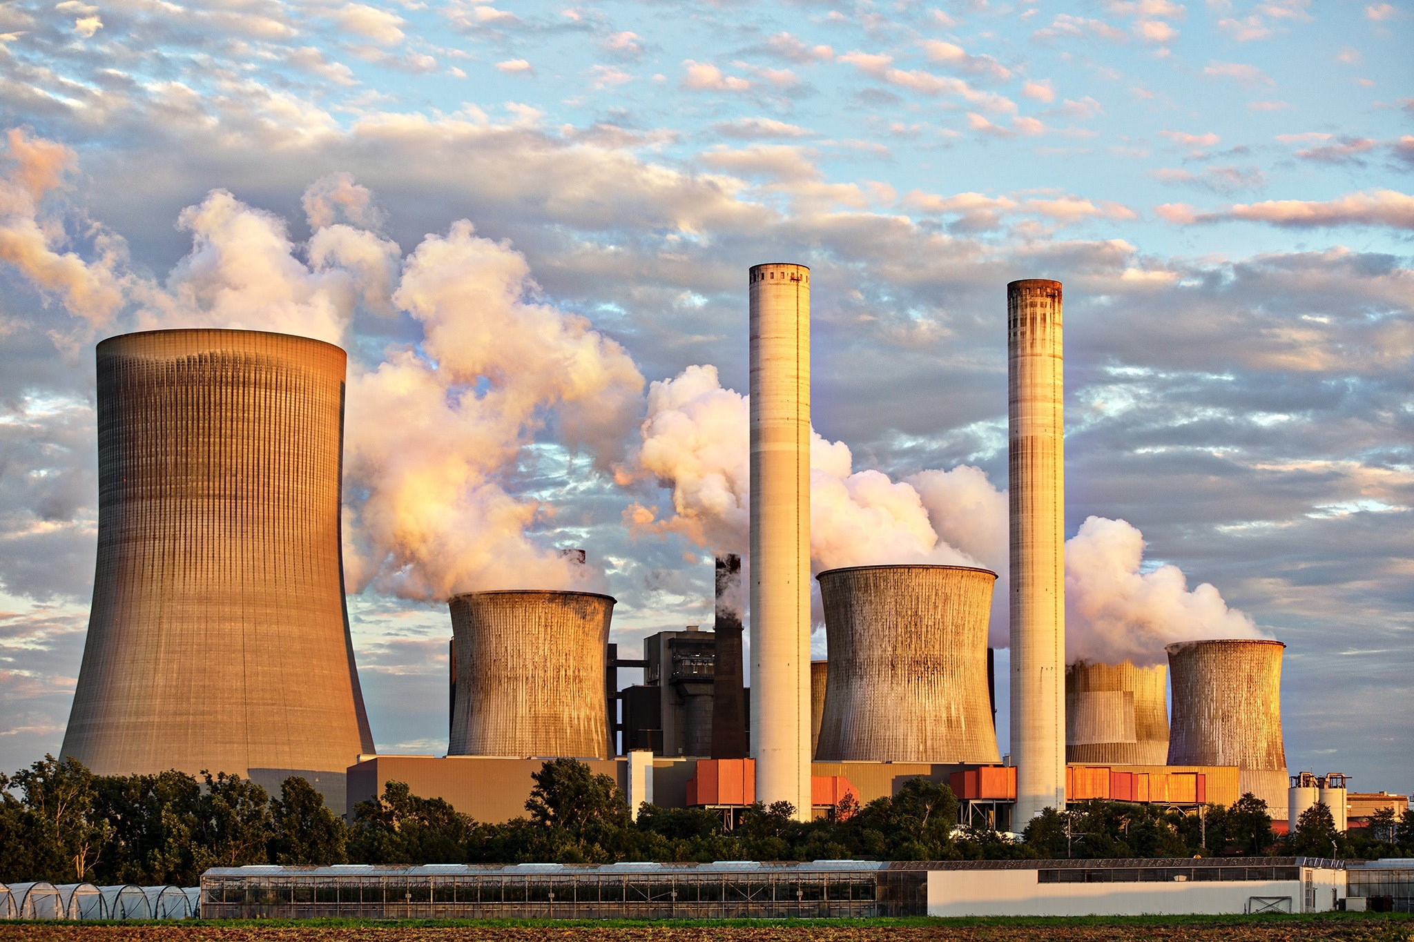
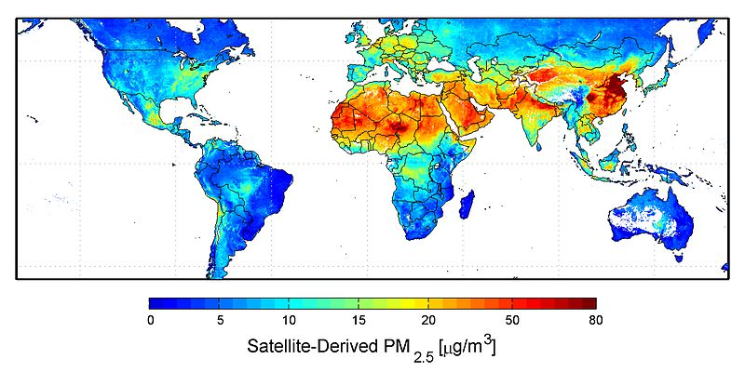
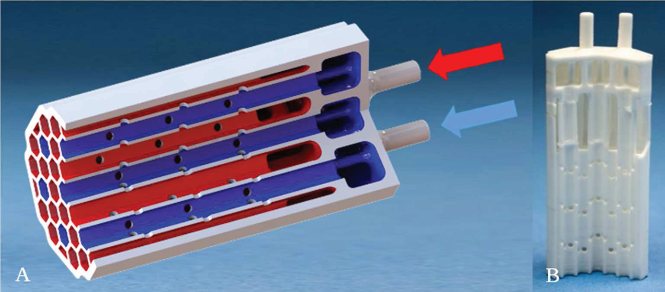
1.1 Introduction —— Heterogeneous catalysts
Heterogeneous catalysts or static mixers are widely applied in chemical industry. Owing to the nature of chemical stability and thermo resistance, complex components made of ceramics could be advantageous in many applications, especially catalyst supports or static mixes and in small-scale decentralized plants, which have gained increasing interest in recent years, e.g. for pollution reduction.
Notes:
随着工业的快速发展，空气污染严重影响人们的健康，而为了更好地解决空气污染的问题，一个较好的思路是从源头入手，采用耐高温和耐化学腐蚀的陶瓷基多相催化剂，使得工业废气中的 CO, NOx 等污染物在高温环境中和基体表面的催化剂发生反应，转化为 CO2, N2 等清洁物质。
作为催化剂的基体，在保证结构强度的同时，还应当根据工作条件、反应介质的不同，考虑单位质量比表面积、单位长度内压降比、流体优化等因素。而在研究中，人们发现蜂巢状结构能兼顾上面这些因素。
而这样的复杂结构对以挤压成型和流延成型为代表的传统陶瓷成型方法提出了挑战。

Slide 3
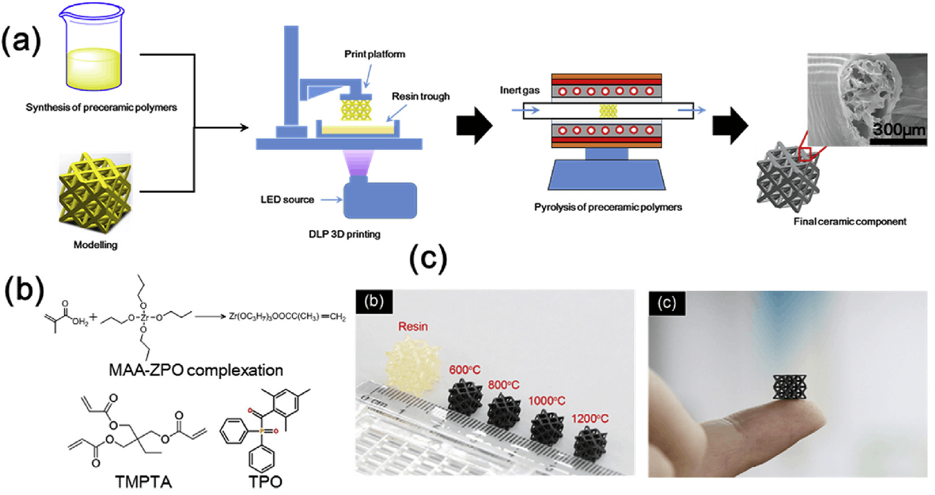
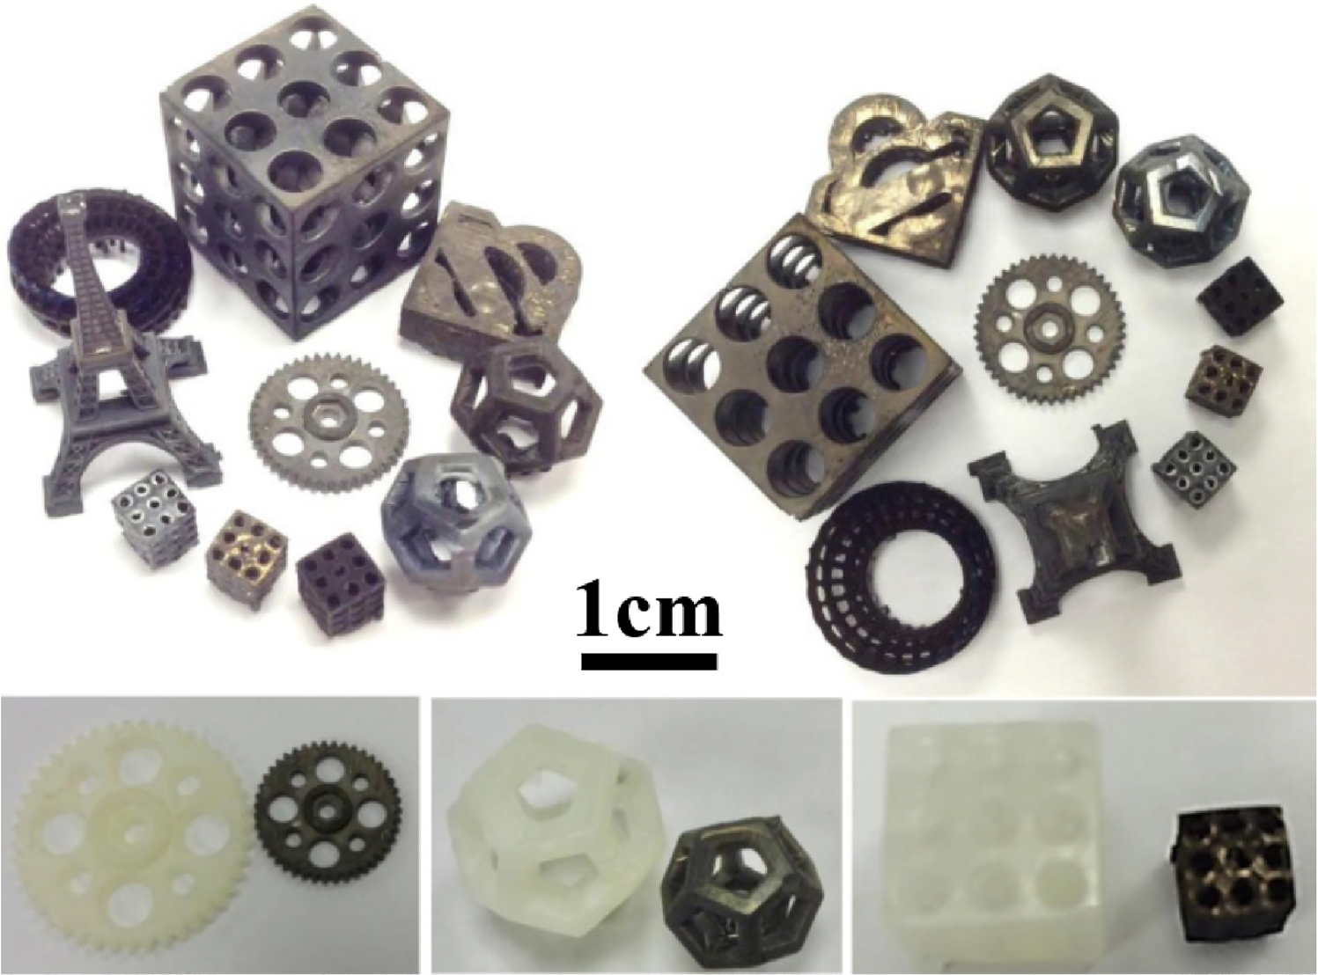
1.2 Introduction —— Stereolithography
The SLA technique is believed to be the most prominent and popular 3D printing technology and has been extensively used worldwide. It utilizes a light source of a certain wavelength (usually in the ultraviolet range) to selectively cure a liquid surface in a vat containing mainly photopolymerizable monomer.
For ceramics, this method is still new and revolutionary. Specially under the fact that the ability to fabricate ceramic components of arbitrarily complex shapes has been extremely challenging without 3D printing.
Notes:
而 3D 打印以其独特的优势可以克服复杂成型的困难。
光固化成型 (Stereolithography，SL/SLA) 作为最常见的 3D 打印技术之一，使用特定波长的光源，在含有光敏树脂的容器中选择性地固化液体表面的特定区域。虽然已有 30 多年的历史，然而，对于陶瓷而言，3D 打印仍然是一种革命性的成型方法。
本研究使用 SLA 技术，以陶瓷粉末混合光敏树脂作为打印材料，实现多相催化剂基体的复杂设计，并利用有限元模拟的方法进行优化

Slide 4
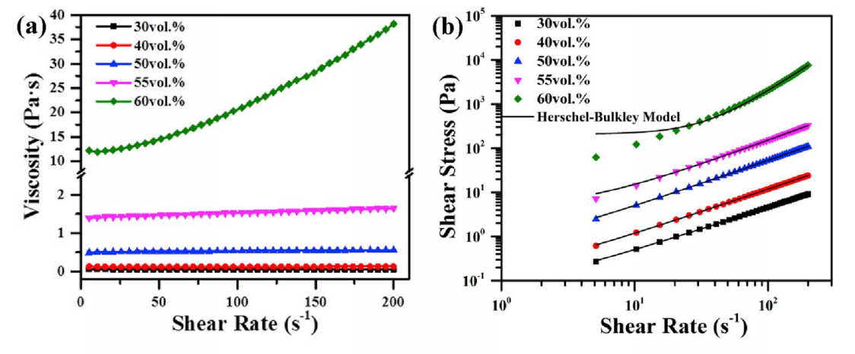
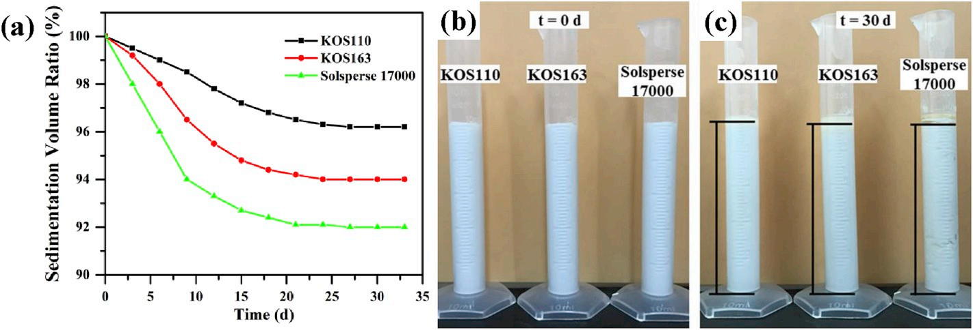
2.1 Challenges —— Mechanical Properities
Appropriate rheological behavior: long-term stability, suitable viscosity, homogeneous, effectively dispersed.
Unstable suspensions with rapid segregation could lead to material inhomogeneity in the fabricated parts. A good candidate for a ceramic suspension should also retain a satisfactory viscosity for proper flow during the printing process.
On the one hand, a higher volume fraction of ceramic particles is favorable for less shrinkage and greater density (thus mechanical strength) after sintering, while, on the other hand, a lower ceramic loading is usually required to minimize the viscosity and avoid possible segregation of the solid content. Therefore, compromises have to be made to prepare suitable ceramic suspensions for SLA.
(a)
(b)
(c)
(d)
Notes:
制备这样的打印材料依然有若干挑战，首先浆料应具有适当的流变特性：包括长期稳定性，适当的粘度，均匀性，无严重的颗粒偏析等。快速偏析的不稳定悬浮液会导致制造零件中的材料不均匀。而过高的粘度使得浆料难以在 SLA 打印机中被打印成型
做到这点的困难之处在于，一方面，我们需要提升浆料中的陶瓷颗粒含量，使得陶瓷烧结后收缩更少、密度更大（从而提高机械强度）；另一方面，过高的陶瓷颗粒含量，会极大地提升粘度并降低稳定性。
（a图 质量分数 粘性性质 切变速率 粘性的变化）（下面图 d 反应浆料的稳定性 未沉淀浆料的体积占比，加分散剂提高稳定性）

Slide 5
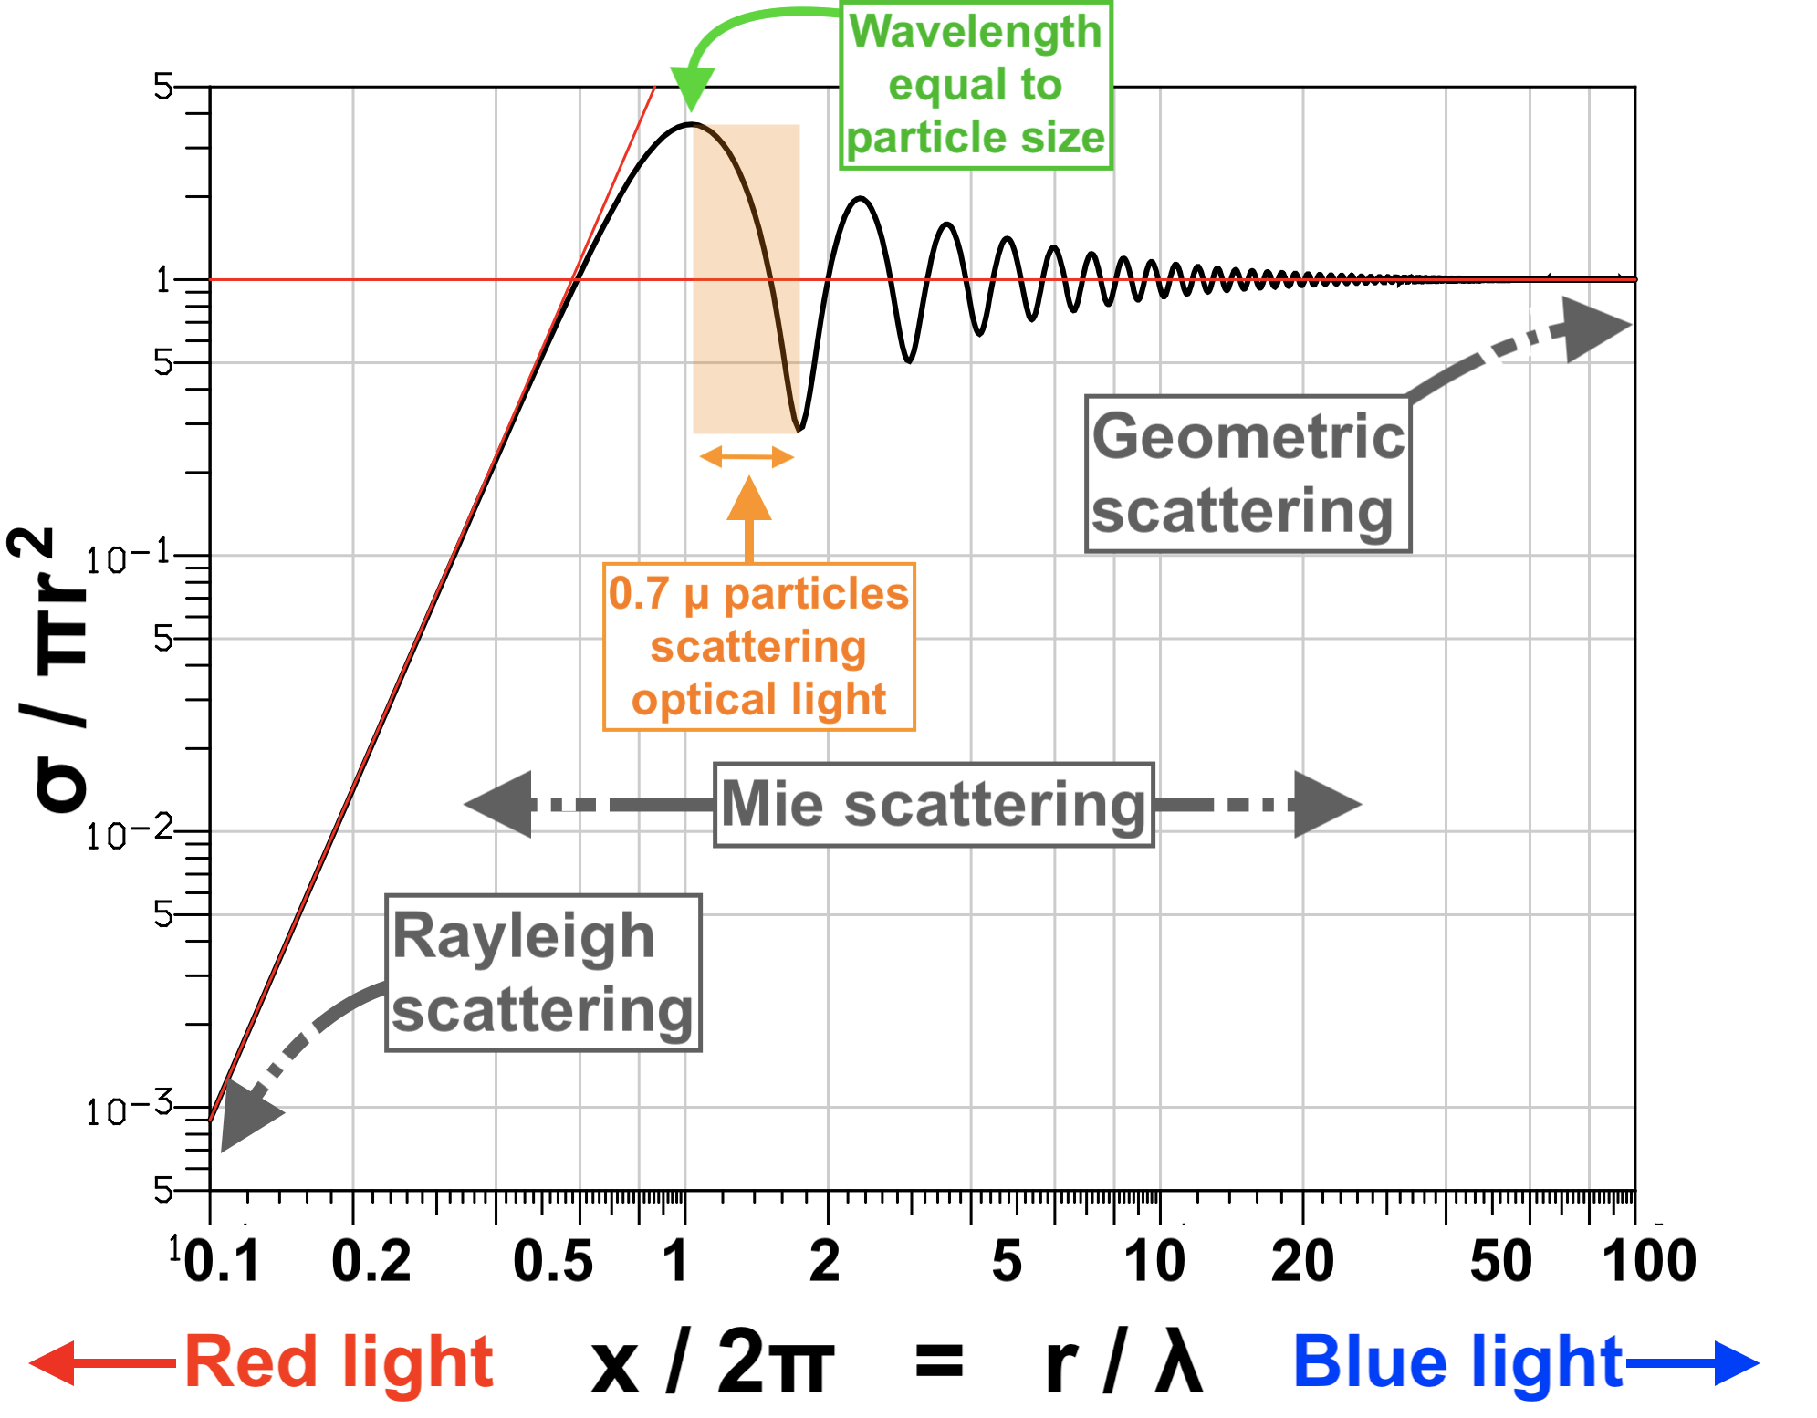
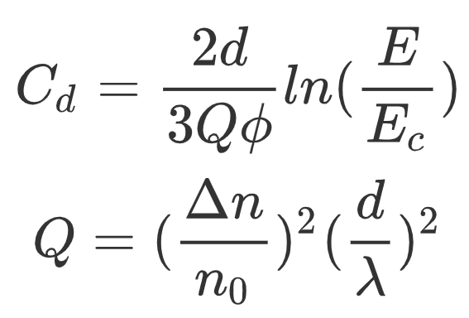
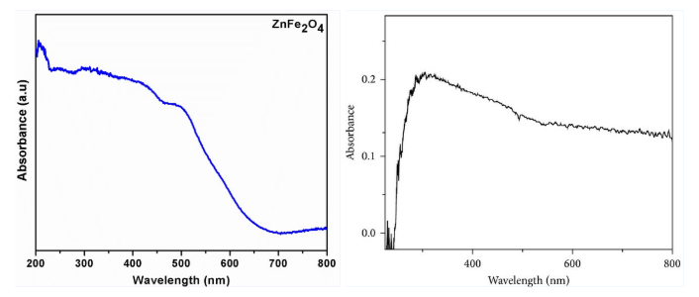
2.2 Challenges —— Optical Properities
Light scattering and absorption arising from the ceramic particles is unfavorable to light penetrating into the suspension, undesirably broadens the lateral curing area (i.e. curing width), which greatly affects the dimensional accuracy of SLA.
The curing depth (and thus the layer thickness) is then associated with the ceramic particle size and volume fraction, light exposure power, and the reflective index of the materials.
Ceramic particles that exhibit greater light absorption and refraction under exposure to the photopolymerization wavelength can be highly challenging to process.
(a)
where d is the mean particle size, ϕ is the volume fraction, Δn is the difference in refractive index
(b)
ZnFe₂O₄
(c)
ZrO₂
Notes:
另一个所必须考虑的关键问题是由添加到树脂中陶瓷颗粒引起的光散射（米散射，a 图）。首先，这种散射不利于紫外光穿透浆料，同时增大了固化宽度，从而影响了 SLA 的成型精度。同时，陶瓷粒子在光固化工作波段下表现出更大的吸收和散射，这对 SLA 工艺的陶瓷应用造成了很大挑战。
另外，由于本实验所采用的 LCD（屏幕材料） 光固化打印机工作波长在 395nm 附近，所以在该波段存在较大吸收峰的物质不适用于采用该成型方法。(b)、(c) 图为 铁氧体 和 二氧化锆 的吸光度曲线，可以看出，铁氧体在紫外段的吸光度较大，相对而言二氧化锆对紫外光的吸收较少，因而是一种更加适合于 SLA 成型的材料。（左下图纵坐标存疑）

Slide 6
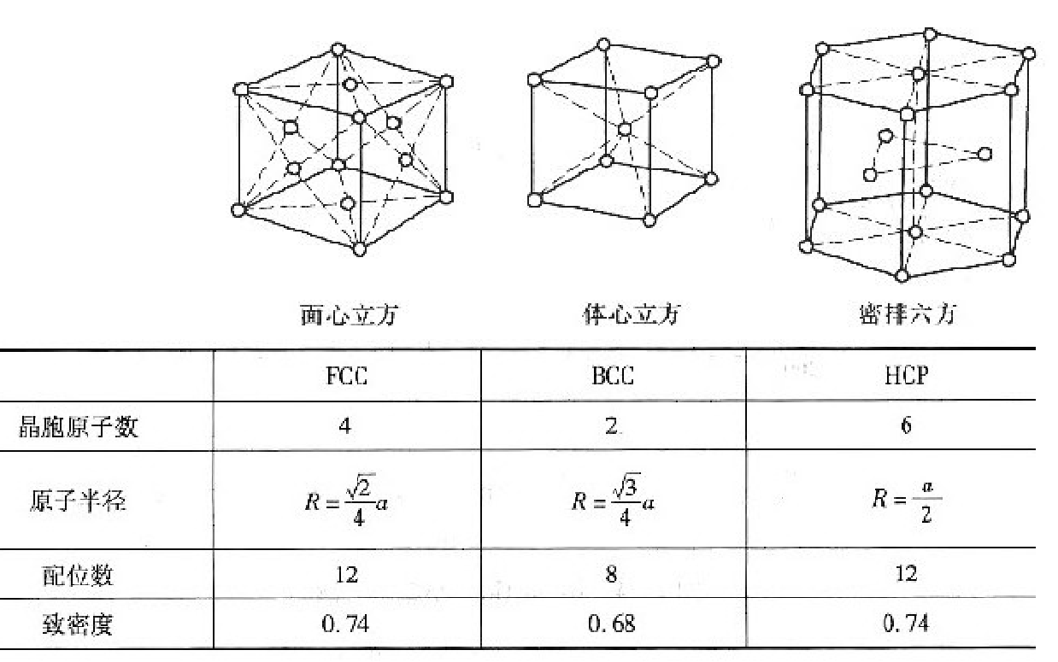
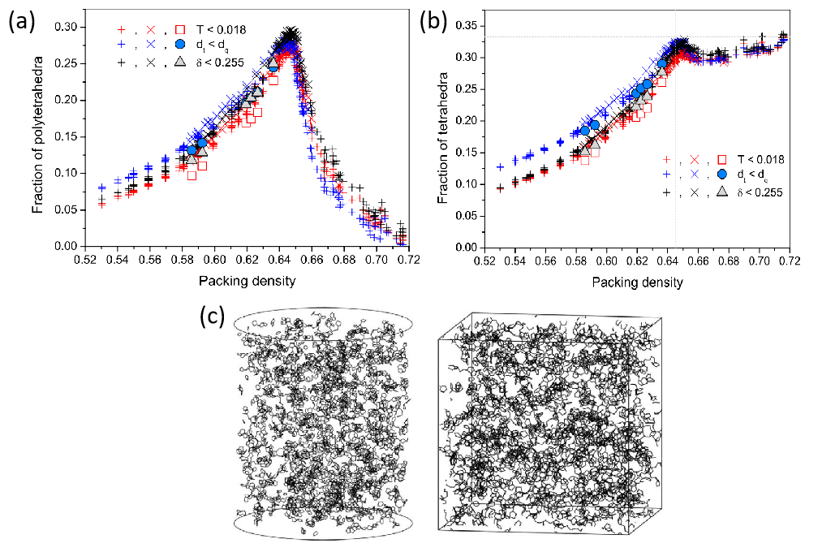
3.1 Methodology —— Theoretical Analysis
We assume that the ceramic particles are spheres. When the ceramic particles adopt a close-packed structure, the structure gap ratio is 25.95%.If the powder presents a completely loose random distribution in space (which is closer to the actual situation), according to the study of Bernal et al., the porosity in this structure is 36.34% (Bernal close packing limit), and the volume of the resin accounts for The ratio should exceed 36.24%.
From the above, it can be assumed that the practical proportion of practical slurry resin should be between 25.95% and 36.34% in weight, and the corresponding powder volume ratio should be between 63.66% and 74.05%. Considering the absorption of resin molecules on the powder surface, the actual powder content will be around 60% or less.
Notes:
为了进一步获取合适的浆料配比和粉末粒径，我们通过理论分析、文献查找和逆向工程相结合的方式。
首先是理论分析。我们假设陶瓷的颗粒为球体，当陶瓷颗粒采用密排结构时，它的结构间隙率为 25.95%；若粉末在空间中呈现完全宽松的随机分布（这更接近实际情况），则由 Bernal (伯纳尔) 等人的研究，这种结构中的孔隙率为 36.34% (Bernal close packing limit)。
由上可知，为了使这些粉末充分分离，实用浆料树脂占比至少应当大于 25.95%~36.34% ，对应粉末体积比在 63.66%~74.05% 之间，考虑粉末表面对树脂分子的吸收，实际的粉末含量最好保持在体积比 60% 以下。

Slide 7
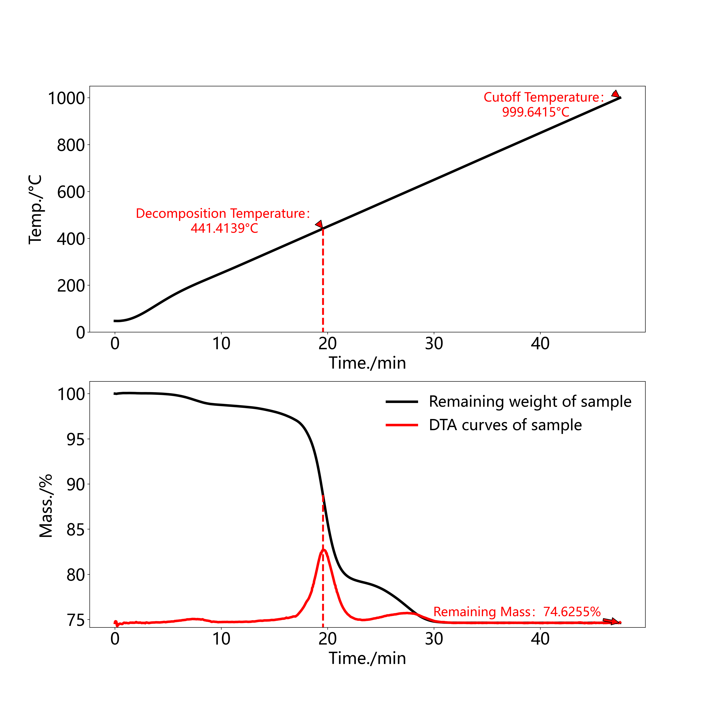
3.2 Methodology —— Reverse Engineering
In terms of reverse engineering, we conducted thermogravimetric analysis on a certain commercial ceramic slurry (a professional ceramic printer is required, the layer needs to be scraped once printed, and the cost is more expensive).
The results are shown below. The above figure shows the differential thermal analysis(DTA) curve, the figure below shows that the organic phase in the slurry is completely decomposed near 450°C, the remaining mass is around 74.5355%, and the equivalent powder volume ratio is around 58%, which is consistent with our expectation.
(a)
(b)
Notes:
逆向工程方面，我们对某种商业的陶瓷浆料 (需要专业的陶瓷打印机，打一层需要刮刀刮一次，机器成本较昂贵) 进行热重分析，结果如下所示，（a）图显示的是热重升温曲线，（b）图显示浆料中的有机相在 450℃ 附近分解完全，剩余质量在 74.5355% 附近，折合粉末体积比在 58% 附近，和理论预期一致。

Slide 8
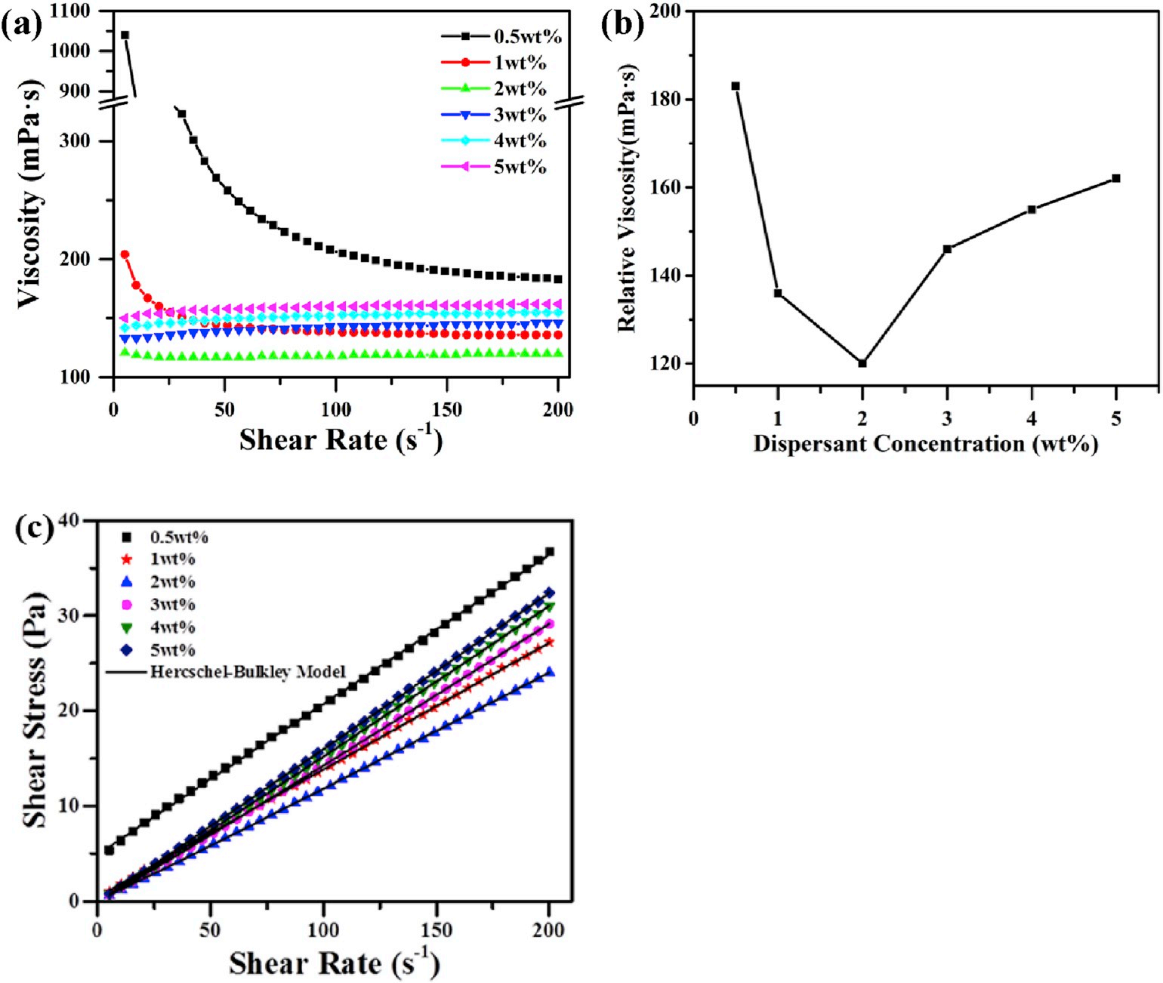
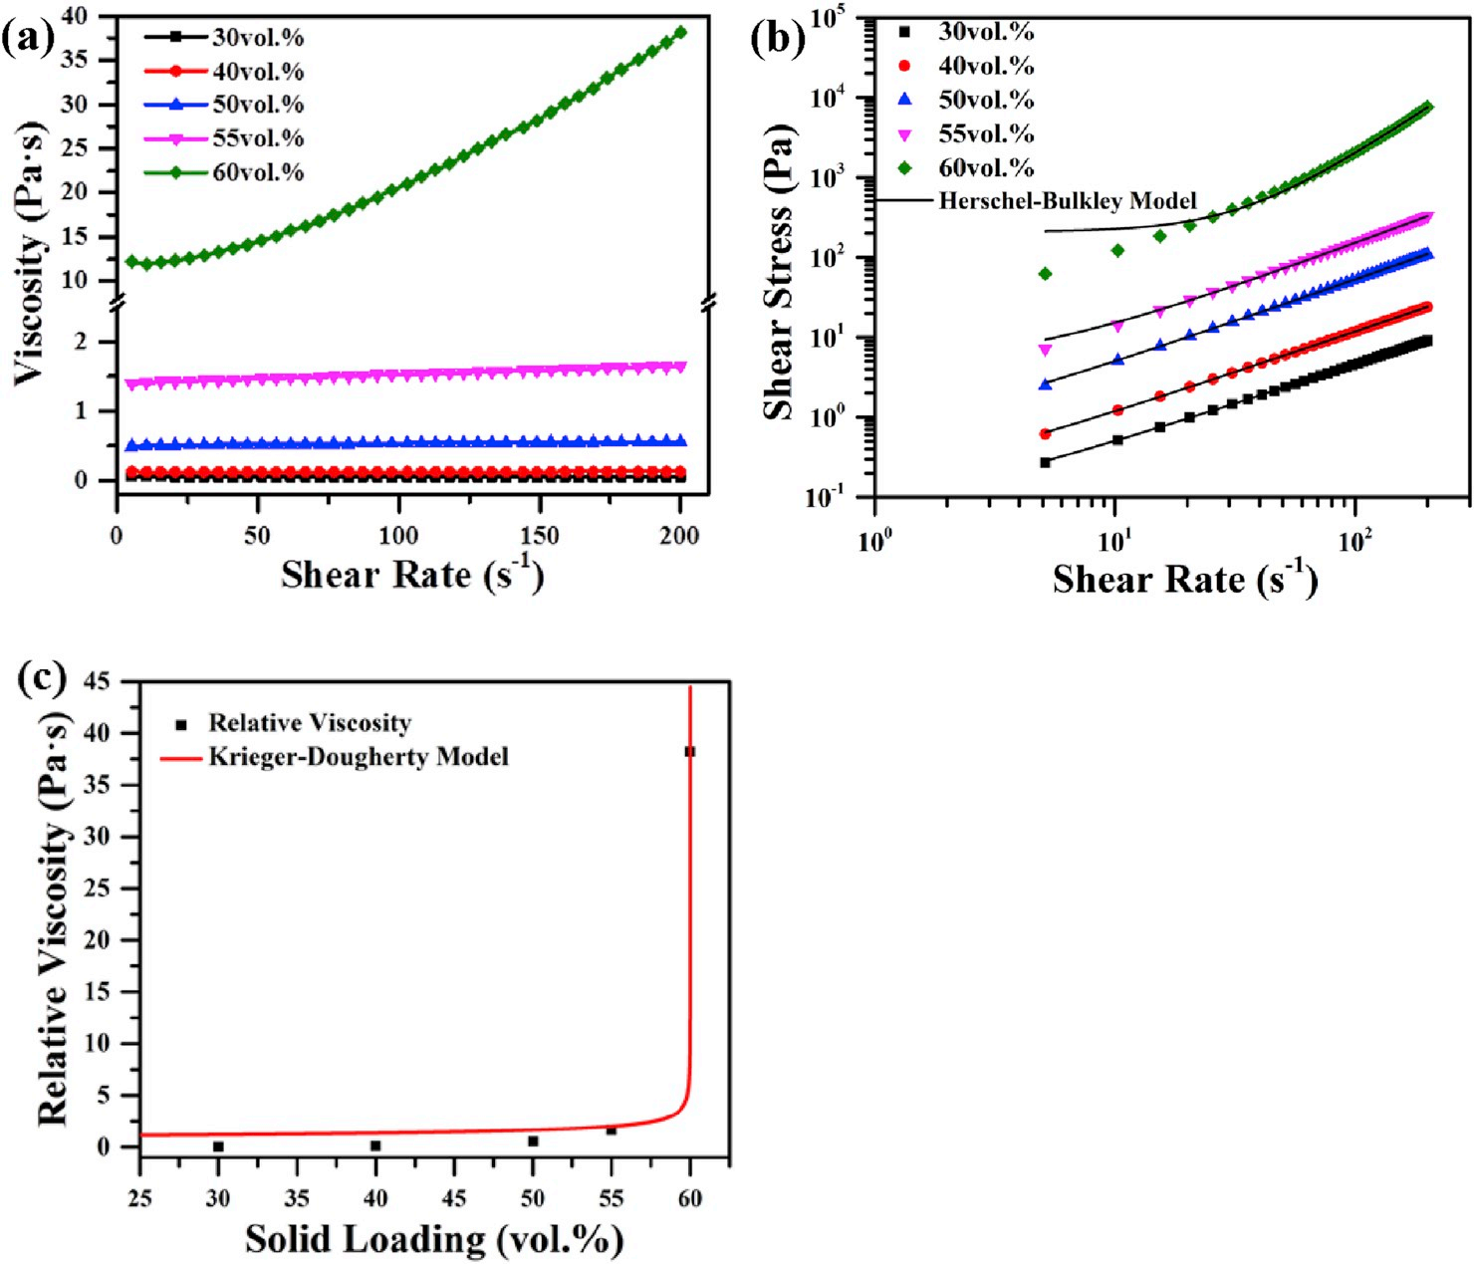
3.3 Methodology —— Literature Search
In order to further obtain the appropriate slurry ratio and powder particle size, we use a combined method of theoretical analysis, literature search and reverse engineering.
we searched through the literature and found that the viscosity of the slurry will increase significantly when the volume of the powder exceeds 60%. As described in the Krieger-Dougherty formula:
When the mass fraction of the dispersant is about 2%, the dispersant reduces the viscosity of the slurry to the greatest extent (the literature utilizes the ester polymer dispersant KOS110).
(a)
(b)
(c)
(d)
Notes:
最后，我们通过文献查找，发现当粉末体积占比超过 60% 时浆料的黏度会明显增大（d 图所示），由 Krieger-Dougherty (克里格-多尔蒂) 公式描述。同时，当分散剂的质量分数为 2% 左右时（b 图所示），分散剂使得浆料的粘度下降的程度最大 (文献采用酯高分子分散剂 KOS110)。

Slide 9
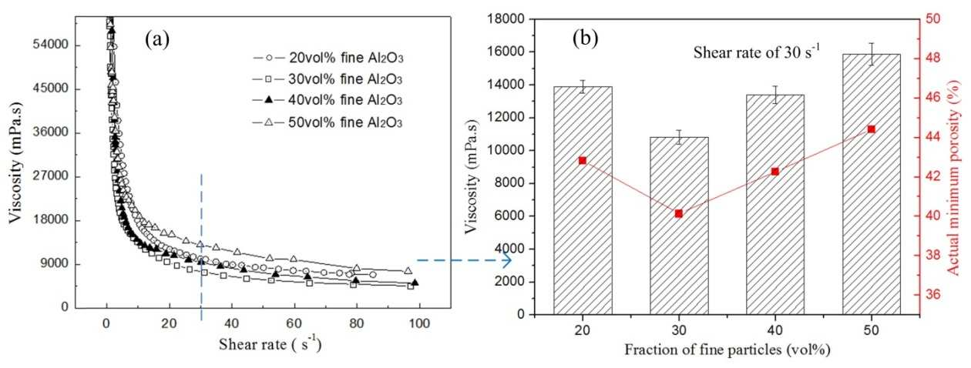
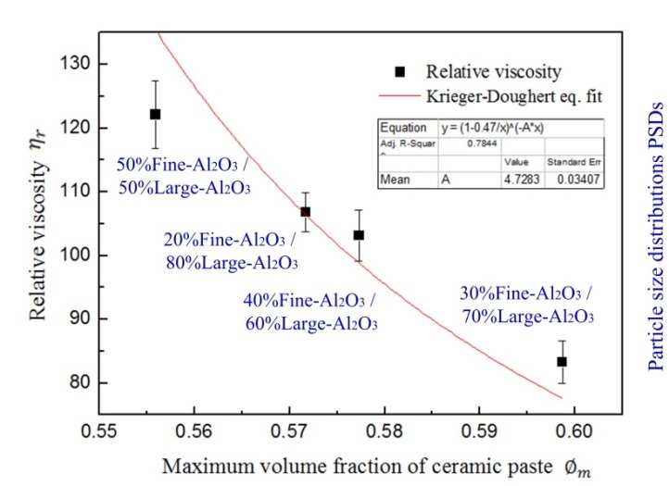
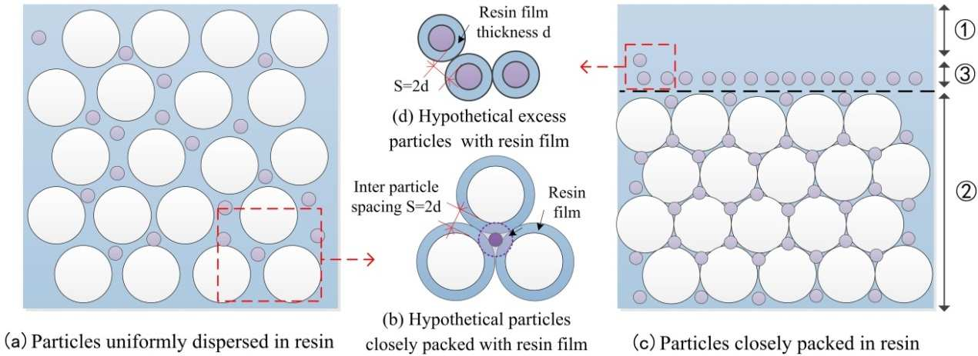
3.4 Methodology —— Effects of PSD
In order to further improve the fluidity and sintering properties of the slurry, we also investigated the influence of the powder particle size distribution (PSD). Previous theoretical and experimental studies have shown that the appropriate broad-peak size distribution of the particles in the suspension increases the apparent density of the green body on the one hand; on the other hand, the presence of coarse particles in the suspension can cause shear-thinning (shear-thinning) behavior, so that the compaction efficiency increases with the width of the PSD.
Further research shows that when the mass ratio of coarse and fine particles is around 7:3, the viscosity of the slurry reaches its minimum.
(a)
(b)
(c)
Notes:
为了进一步改善浆料的流动性能以及烧结性能，我们还考察了陶瓷粉末 粒径分布 (PSD) 的影响。
先前的理论和实验结果表明，悬浮液中颗粒的 宽峰PSD 一方面增加了坯体的表观密度；另一方面，悬浮液中粗颗粒的存在会导致剪切薄化 (shear-thinning) 行为，使得压实效率 (单位体积树脂能承载的陶瓷体积) 随着粒径分布的宽度的增加而增加，它的原理如（c）图所示。
而进一步的研究表明，粗细颗粒的质量比在 7：3 附近时，陶瓷浆料的粘度有最小值，如（a）、（b）图所示。

Slide 10
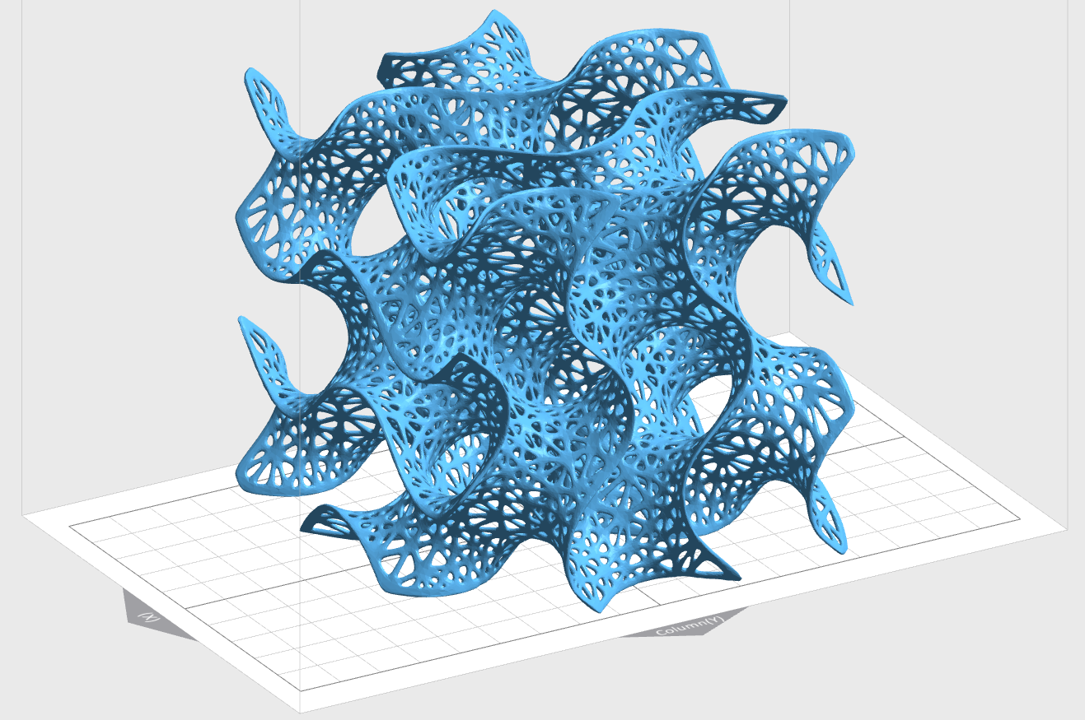
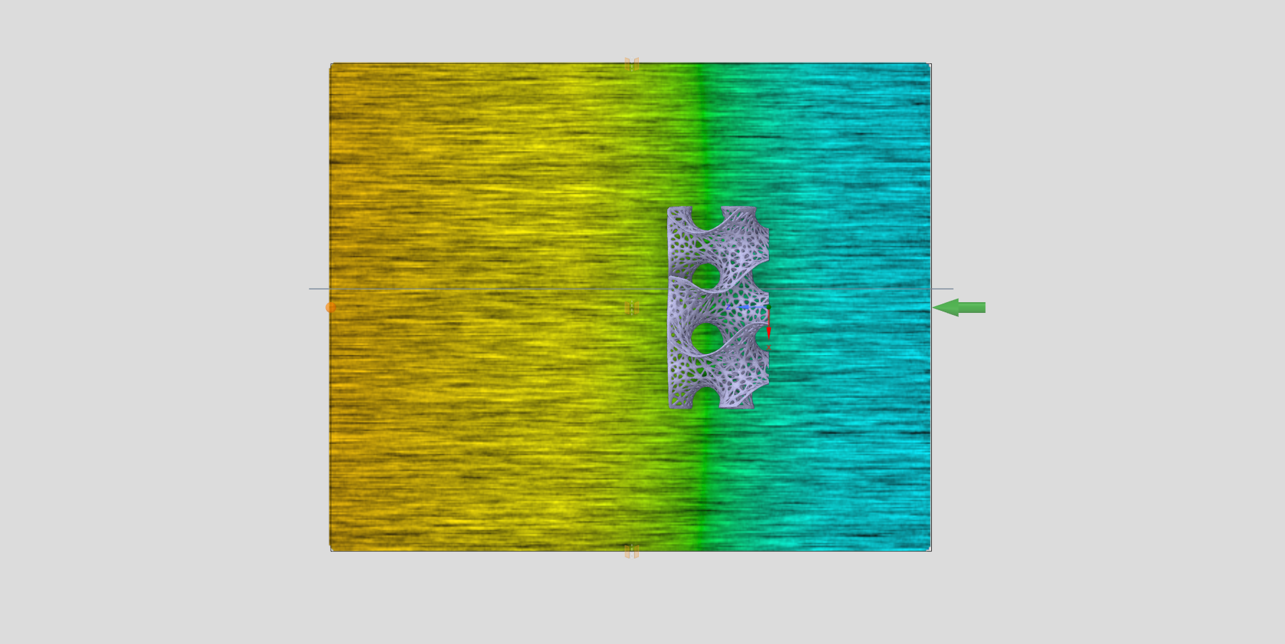
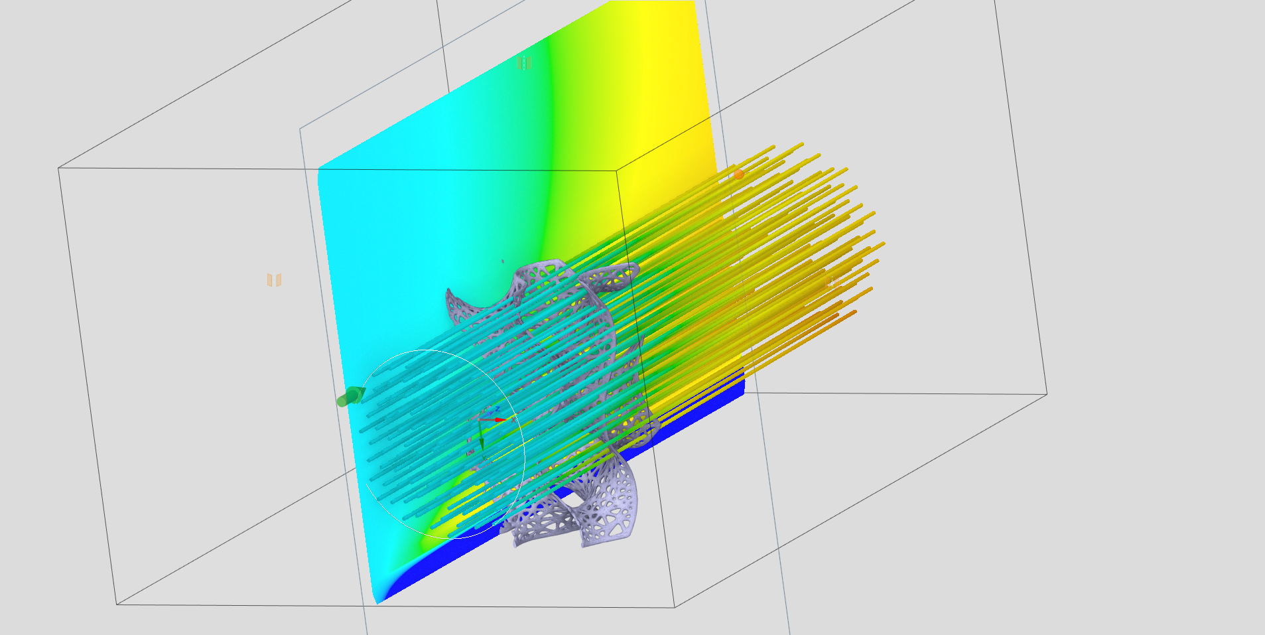
3.5 Methodology —— CAD design and Flow field FEA
After selecting the appropriate materials and configuration parameters, we use the method of computer-aided design and flow field finite element analysis (FEA) to obtain the ceramic matrix shape which is conducive to expanding the effective contact area of the reaction.
In the process of finite element simulation, we found that the three-dimensional honeycomb structure can disperse the medium better than the traditional ordered structure, thus promoting the reaction It can keep good structural strength while reducing material consumption
(a)
(b)
(c)
Notes:
在选定了合适的材料以及配置参数后，我们使用计算机建模和流场有限元模拟相结合的方法获得有利于扩大反应有效接触面积的陶瓷基体形状，在有限元模拟的过程中，我们发现这样的三维蜂窝状结构相对于传统有序结构而言能更好地分散介质，从而促进反应的发生；在减少用料的同时，能保持较好的结构强度

Slide 11
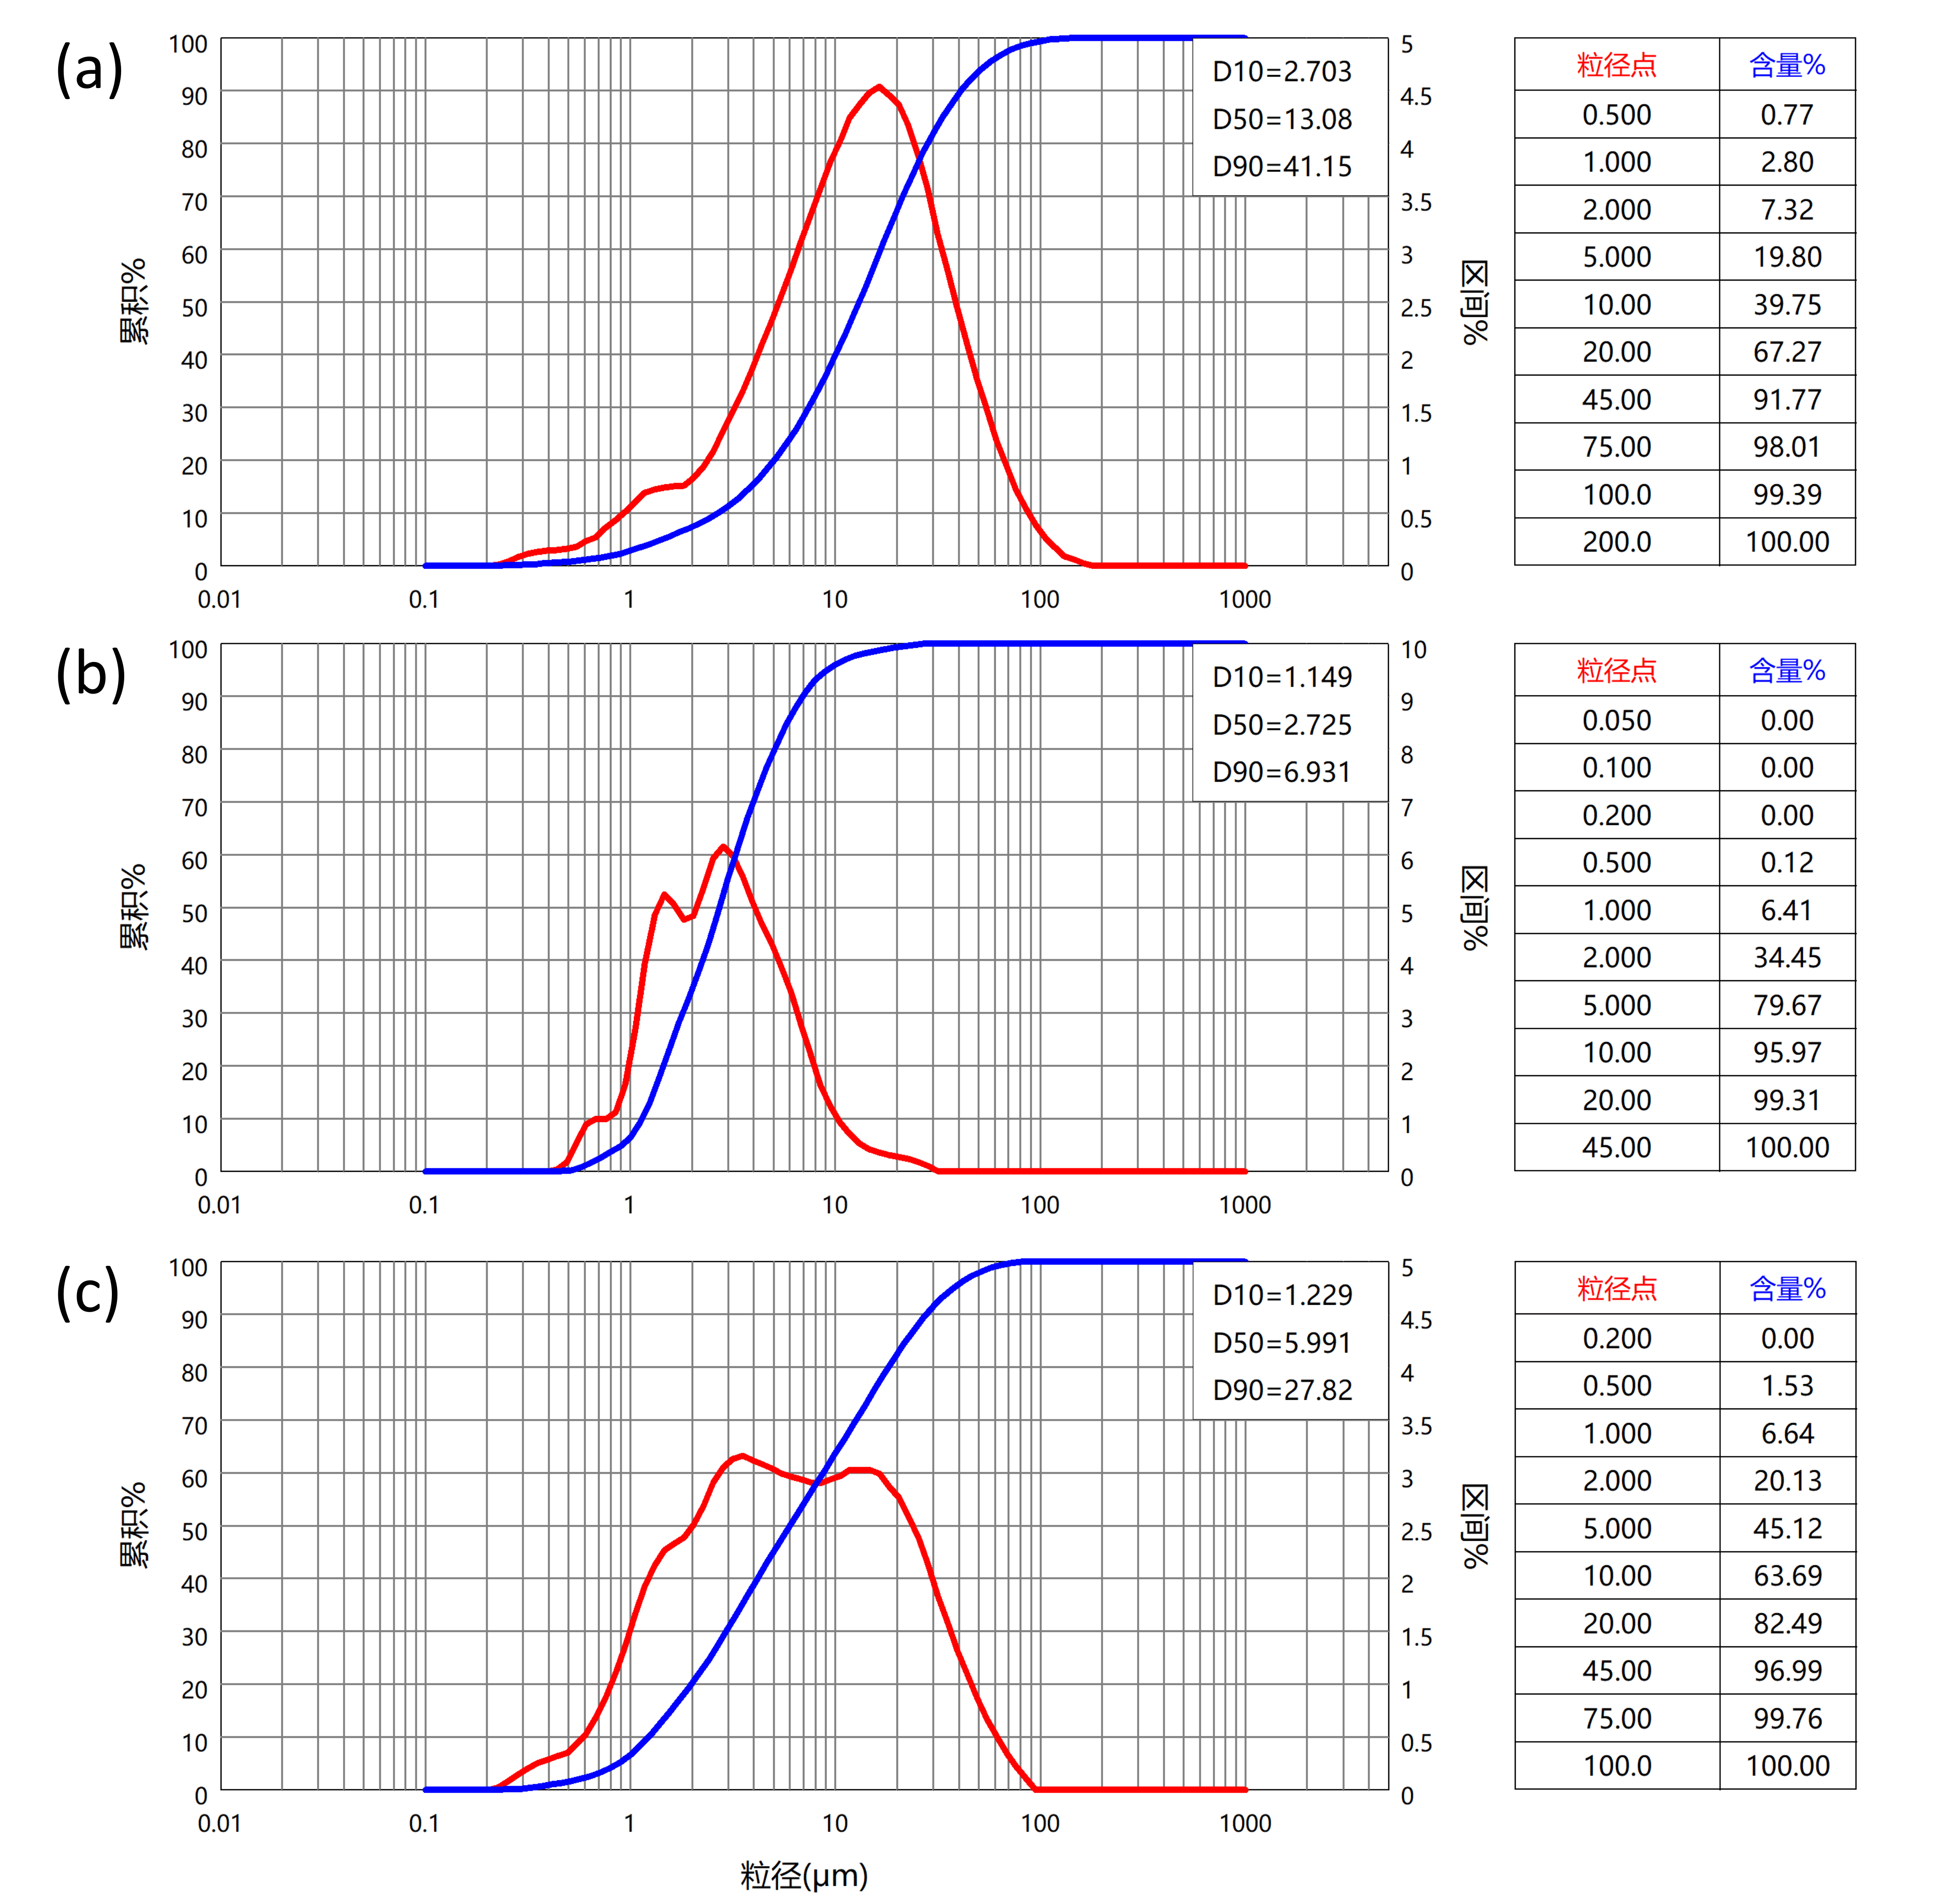
4.1 Experiments —— Ceramic Powder Preparation
After the above discussion, we decided to combine two particle sizes of ZrO₂ of 1250 mesh (12 μm) and 3000 mesh (5.0 μm) according to mass ratio 7:3, and then a total fraction 3wt% of yttrium oxide(Y₂O₃) is added as the Crystalline stabilizer.
Based on previous reverse engineering measurement results, our light-curing slurry is configured at a mass ratio of 75%. The particle size distribution of this mixture can be characterized by a laser particle size tester. The results are shown in the figure below. It can be seen that a wide range of particle size distribution (from about 100 μm to 0.2μm) is obtained after our treatment.
Notes:
经过上面的讨论，我们决定选用 1250目 和 3000目 两种粒径的 $ZrO_2$ 粉末按质量进行 7：3 混合后，再加入总质量 3wt% 的氧化钇，而后按照 75% 的质量比配置光固化浆料。混合后的粒径分布可使用激光粒度测试仪进行表征，（粗，细，混合物）从上到下可看出，可以看到经过上述处理后得到了较宽的粒径分布范围。

Slide 12
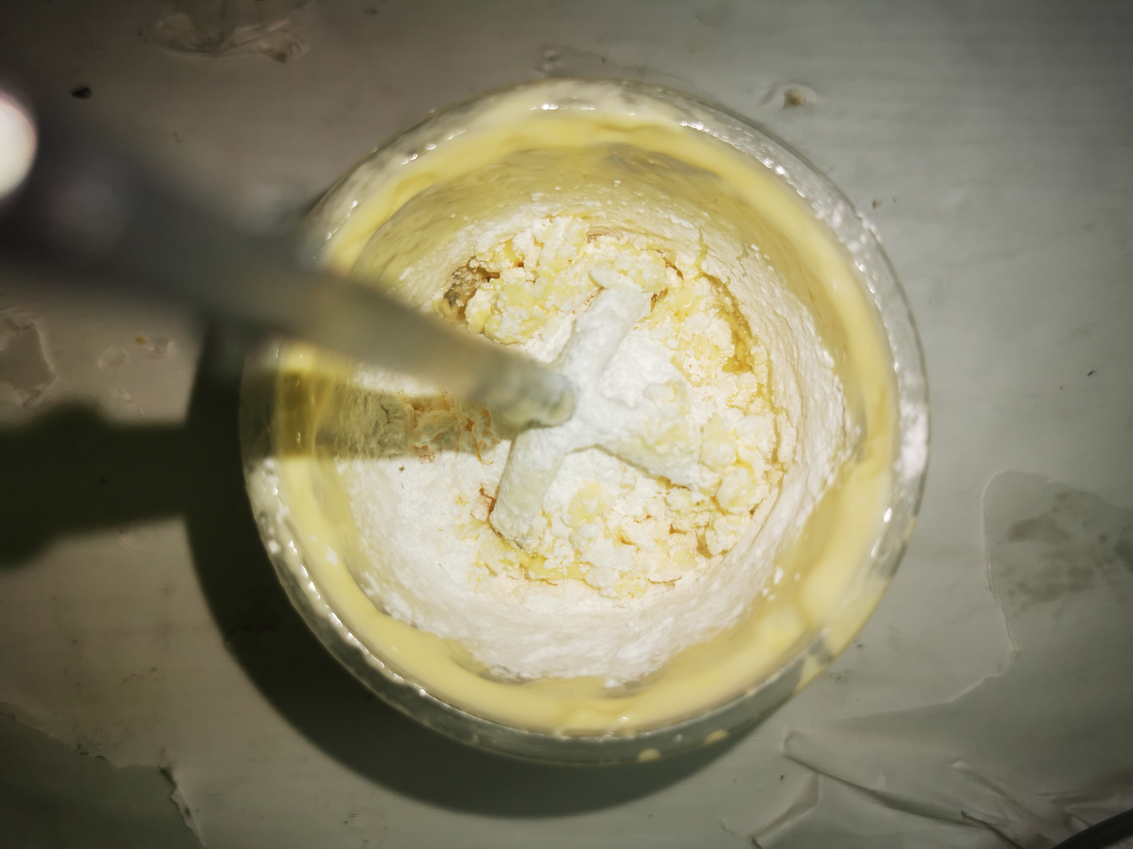
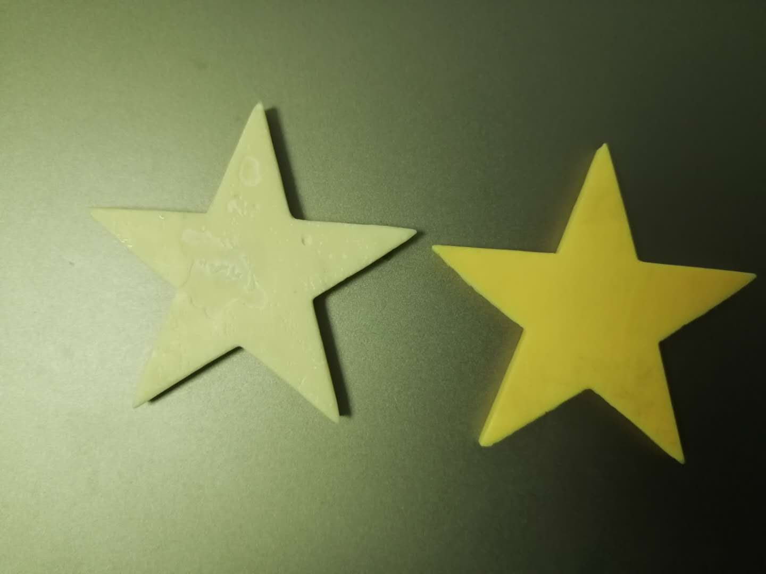
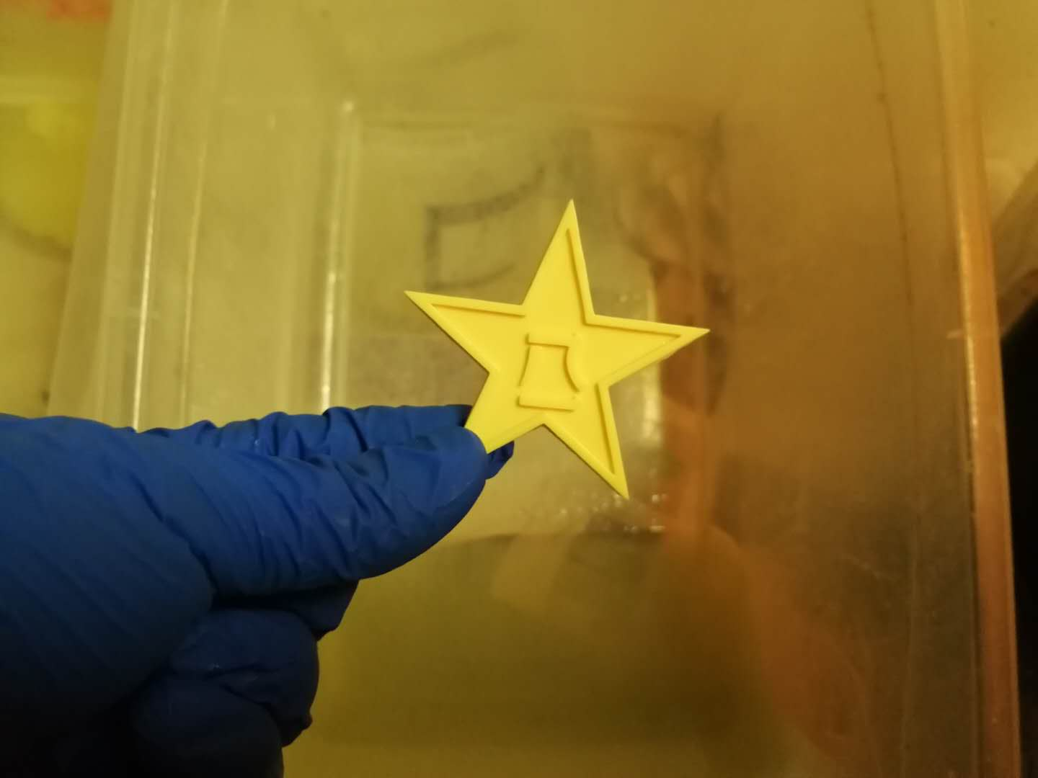
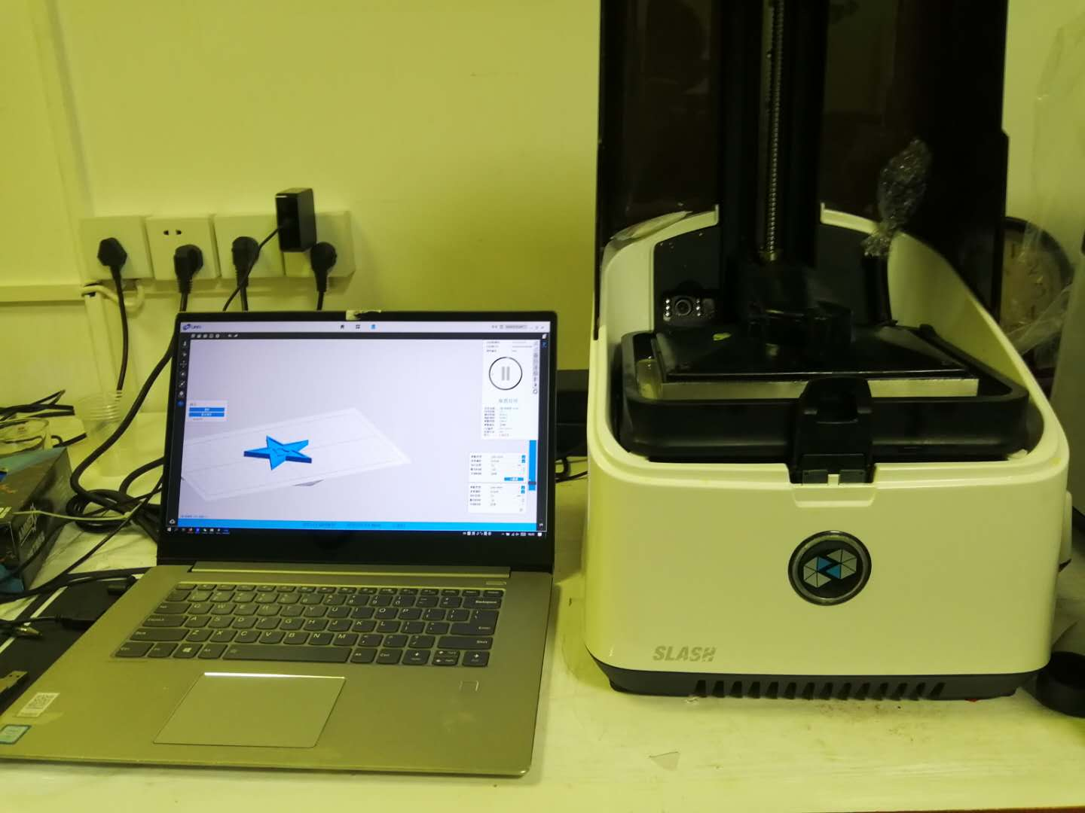
4.2 Experiments —— Slurry and Sample Preparation
In the first day of our experiment, we resort to a mechanical mixing method, and the powder mass fraction of the slurry was around 45 wt%. In the experiment the next day, an ultrasonic cleaner was used to remove bubbles, but the slurry viscosity was too large and the bubbles were difficult to move, which was not successful.
On the third day, we added a certain amount of SN5040 polycarboxylate sodium anionic dispersant, and replaced with the 3:7 mixed powder, which we found can maintain the processability (viscosity) of the slurry while increasing the mass fraction of the powder by half, to an extend of about 65 wt%.
(a)
(b)
(c)
(d)
Notes:
在第一天的打印中，我们采用的浆料混合方式为单纯的机械混合，陶瓷粉末质量分数在 45 wt% 附近。但在实际过程中我们发现这种方式会产生较多气泡，在打印出的试件背板上可以观察到疏孔的存在，如下图所示。第二天的打印中尝试用超声波清洗仪去除气泡，但因浆料粘度过大，气泡难以运动而不太成功。
第三天的打印中，我们添加一定量的 SN5040 聚羧酸钠盐型阴离子分散剂，并换用了混合粉末，在保持可加工性（黏度）的情况下将粉末的质量分数提升了一半，来到 65 wt% 附近。

Slide 13
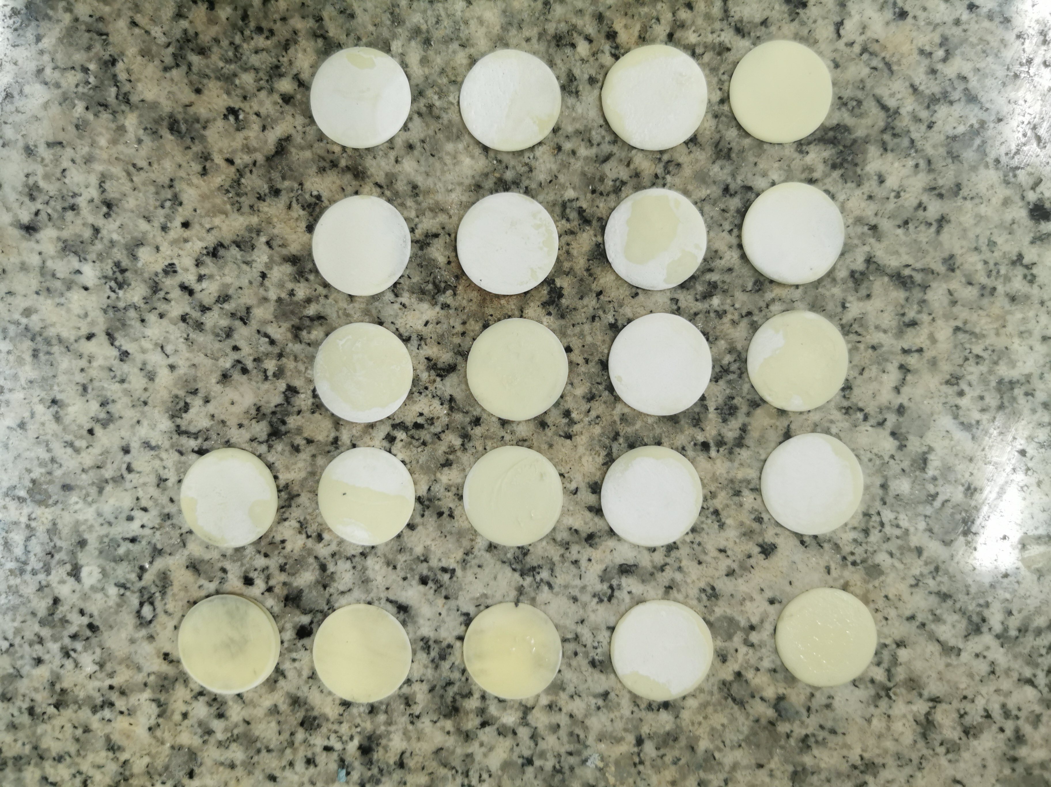
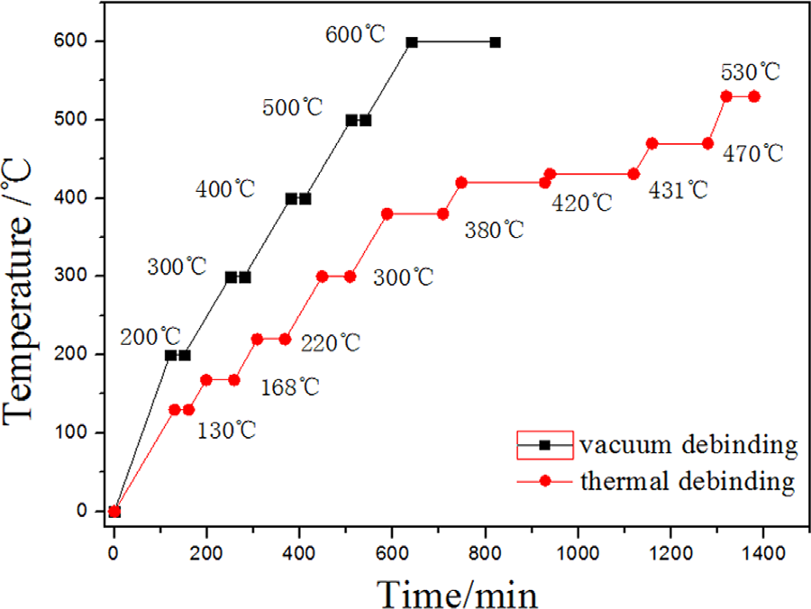
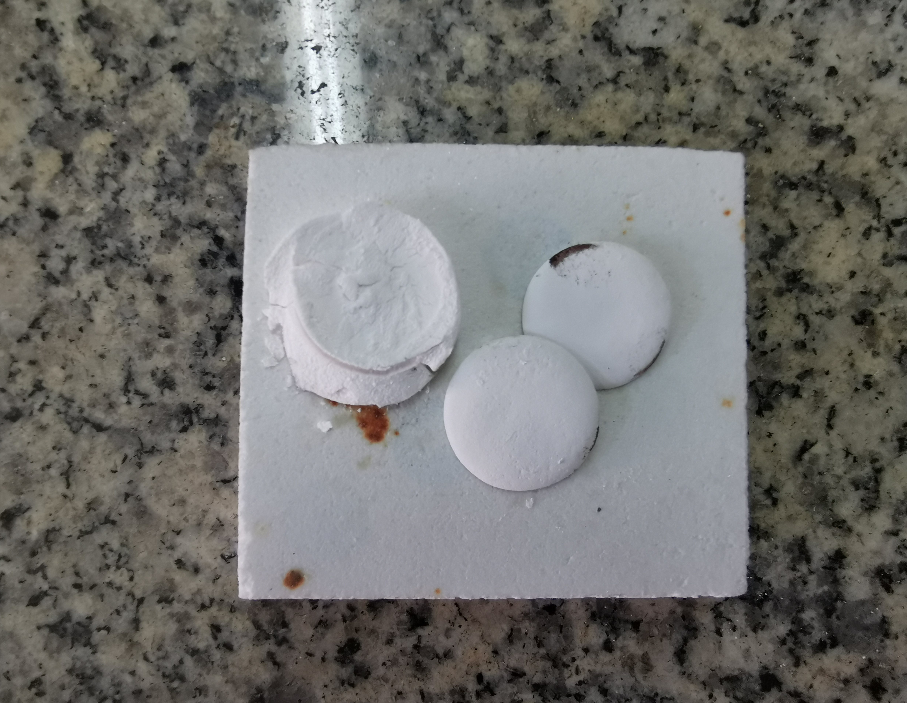
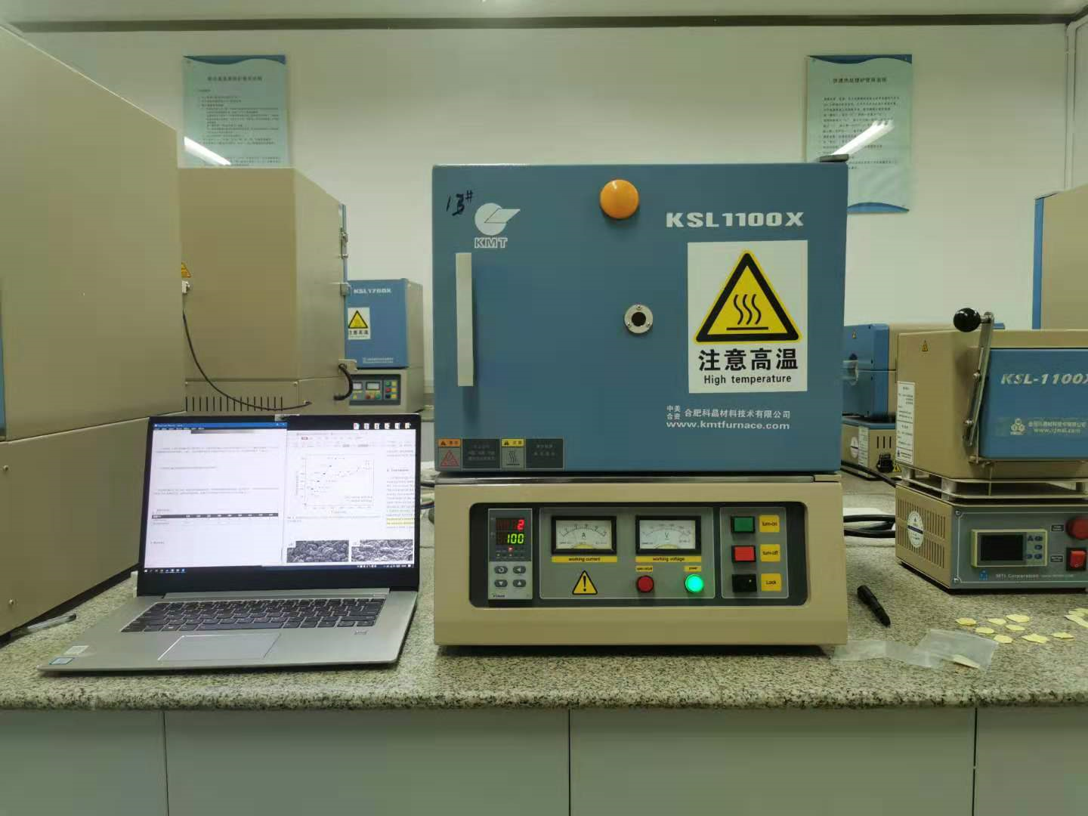
4.3 Experiments —— Debinding and Sintering Process
The debinding process was conducted in 300~500 ℃, as is shown in figure (b). We can see that the color of the green body faded and turned into the base color of ZrO₂. The debinded sample had no obvious defects, while the DTA shows that the organic components in the material have been completely removed.
After confirming that our degreasing process can completely remove the resin from the material, we conducted the sintering at a temperature of 1600℃.
(a)
(b)
(c)
(d)
Notes:
而后我们通过在 300~500℃ 温度范围内的脱脂处理，得到我们需要的陶瓷素胚，如下图所示，可以看到胚体的颜色已经褪去而呈 $ZrO_2$ 固有的白色，试样没有明显缺陷，热重分析表明材料中的有机成分已经完全脱去。

Slide 14
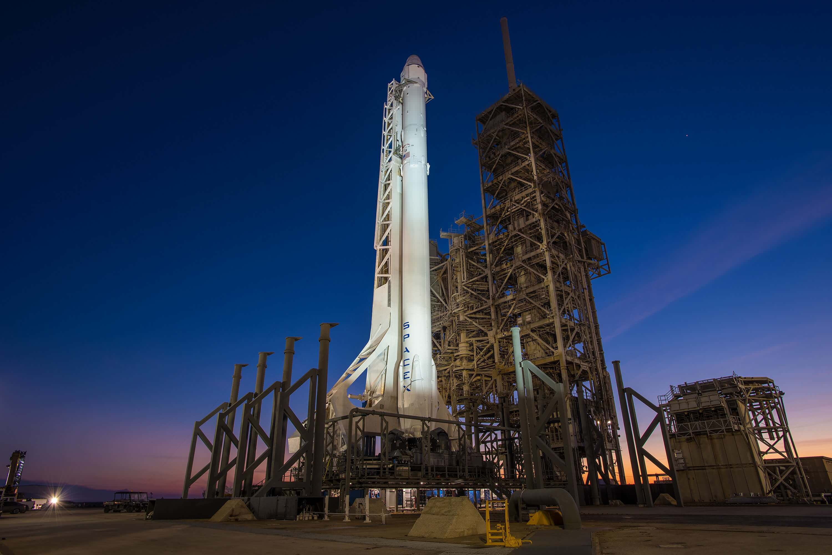
欢迎大家批评指正！

